Slide 1
A Family Experience with Open Access Personal Genomics
Manuel Corpas
Festival of Genomics, London, 31st Jan 2017
@manuelcorpas

Slide 2
Disclaimer I
ALL EXPERIMENTS, DATA, FINDINGS ARE THE RESULT OF PRIVATE EFFORTS

Slide 3
Disclaimer II
INDIVIDUALS INVOLVED HAVE PROVIDED INFORMED CONSENT TO SHARE THEIR DATA

Slide 4
Disclaimer III
MY CURRENT OR PAST EMPLOYERS DO NOT NECESSARILY ENDORSE ANY FINDINGS, METHODS OR CONCLUSIONS, DIRECTLY OR INDIRECTEDLY RELATED TO THIS STUDY

Slide 5
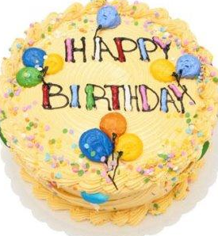
May 2009

Slide 6
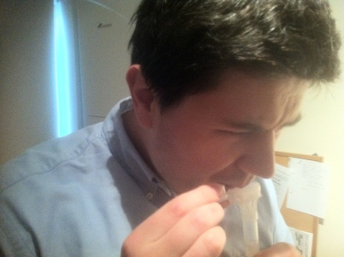

Slide 7
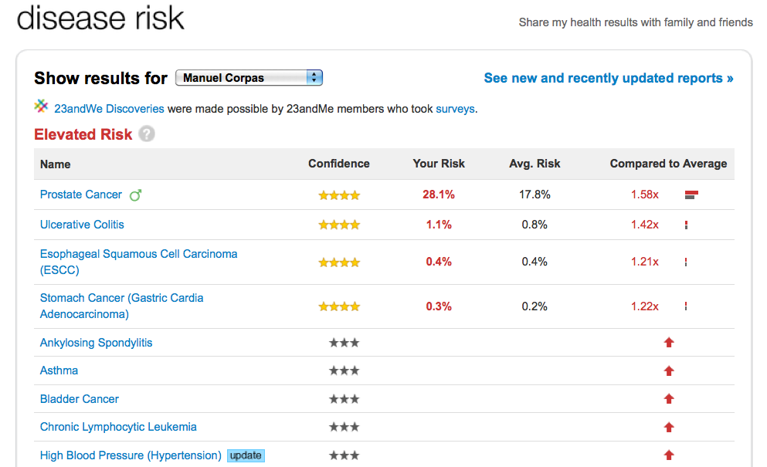

Slide 8
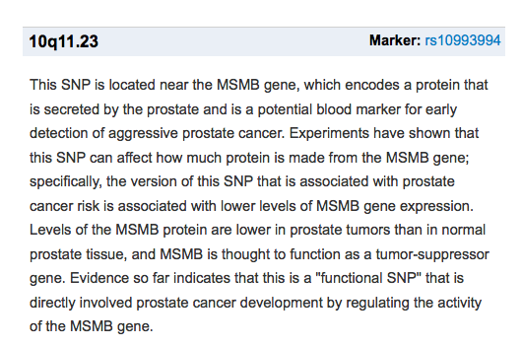
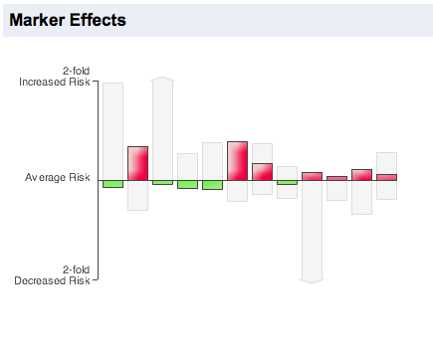

Slide 9
Not enough…

Slide 10
Is this all there is?
How far can we go in our way to understanding our own genetic data?

Slide 11
Wish list

Slide 12
Wish list
I want to browse my own genome

Slide 13
Wish list
I want to browse my own genome
Check provenance of results

Slide 14
Wish list
I want to browse my own genome
Check provenance of results
Understand how I inherited my traits

Slide 15
Navigating my own personal genome

Slide 16
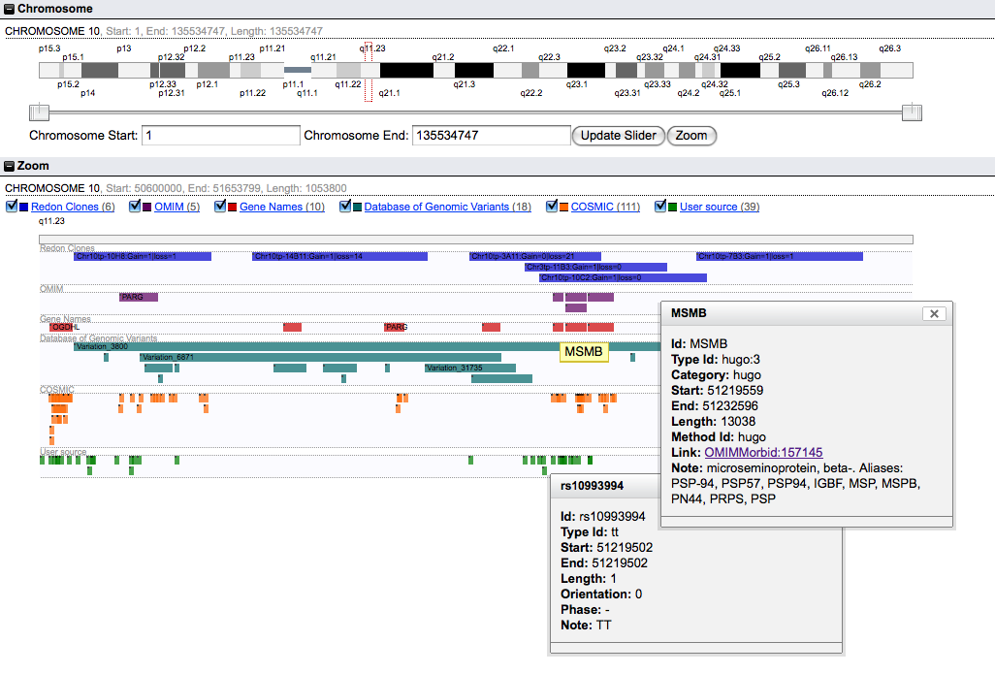

Slide 17
Is this all there is?
How much further we understand our own genetic data?

Slide 18
More questions than answers

Slide 19
More questions than answers
How did I inherit my prostate cancer risk?

Slide 20
More questions than answers
How did I inherit my prostate cancer risk?
  No history in the family of prostate cancer

Slide 21
More questions than answers
How did I inherit my prostate cancer risk?
  No history in the family of prostate cancer
Is this a real or an artifact?

Slide 22
More questions than answers
How did I inherit my prostate cancer risk?
  No history in the family of prostate cancer
Is this a real or an artifact?
Are my parents actually carriers?

Slide 23
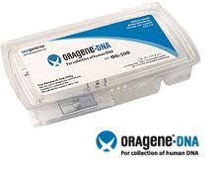
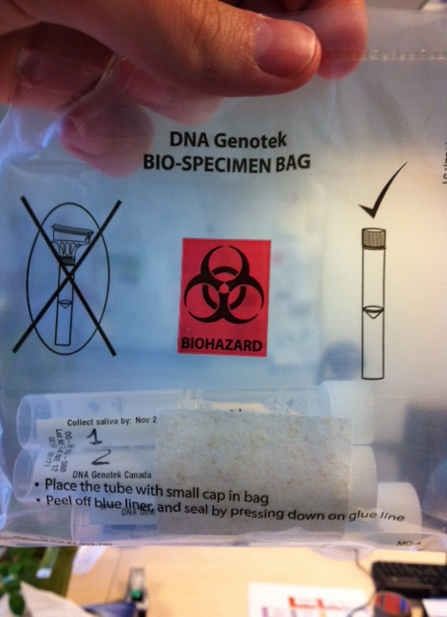
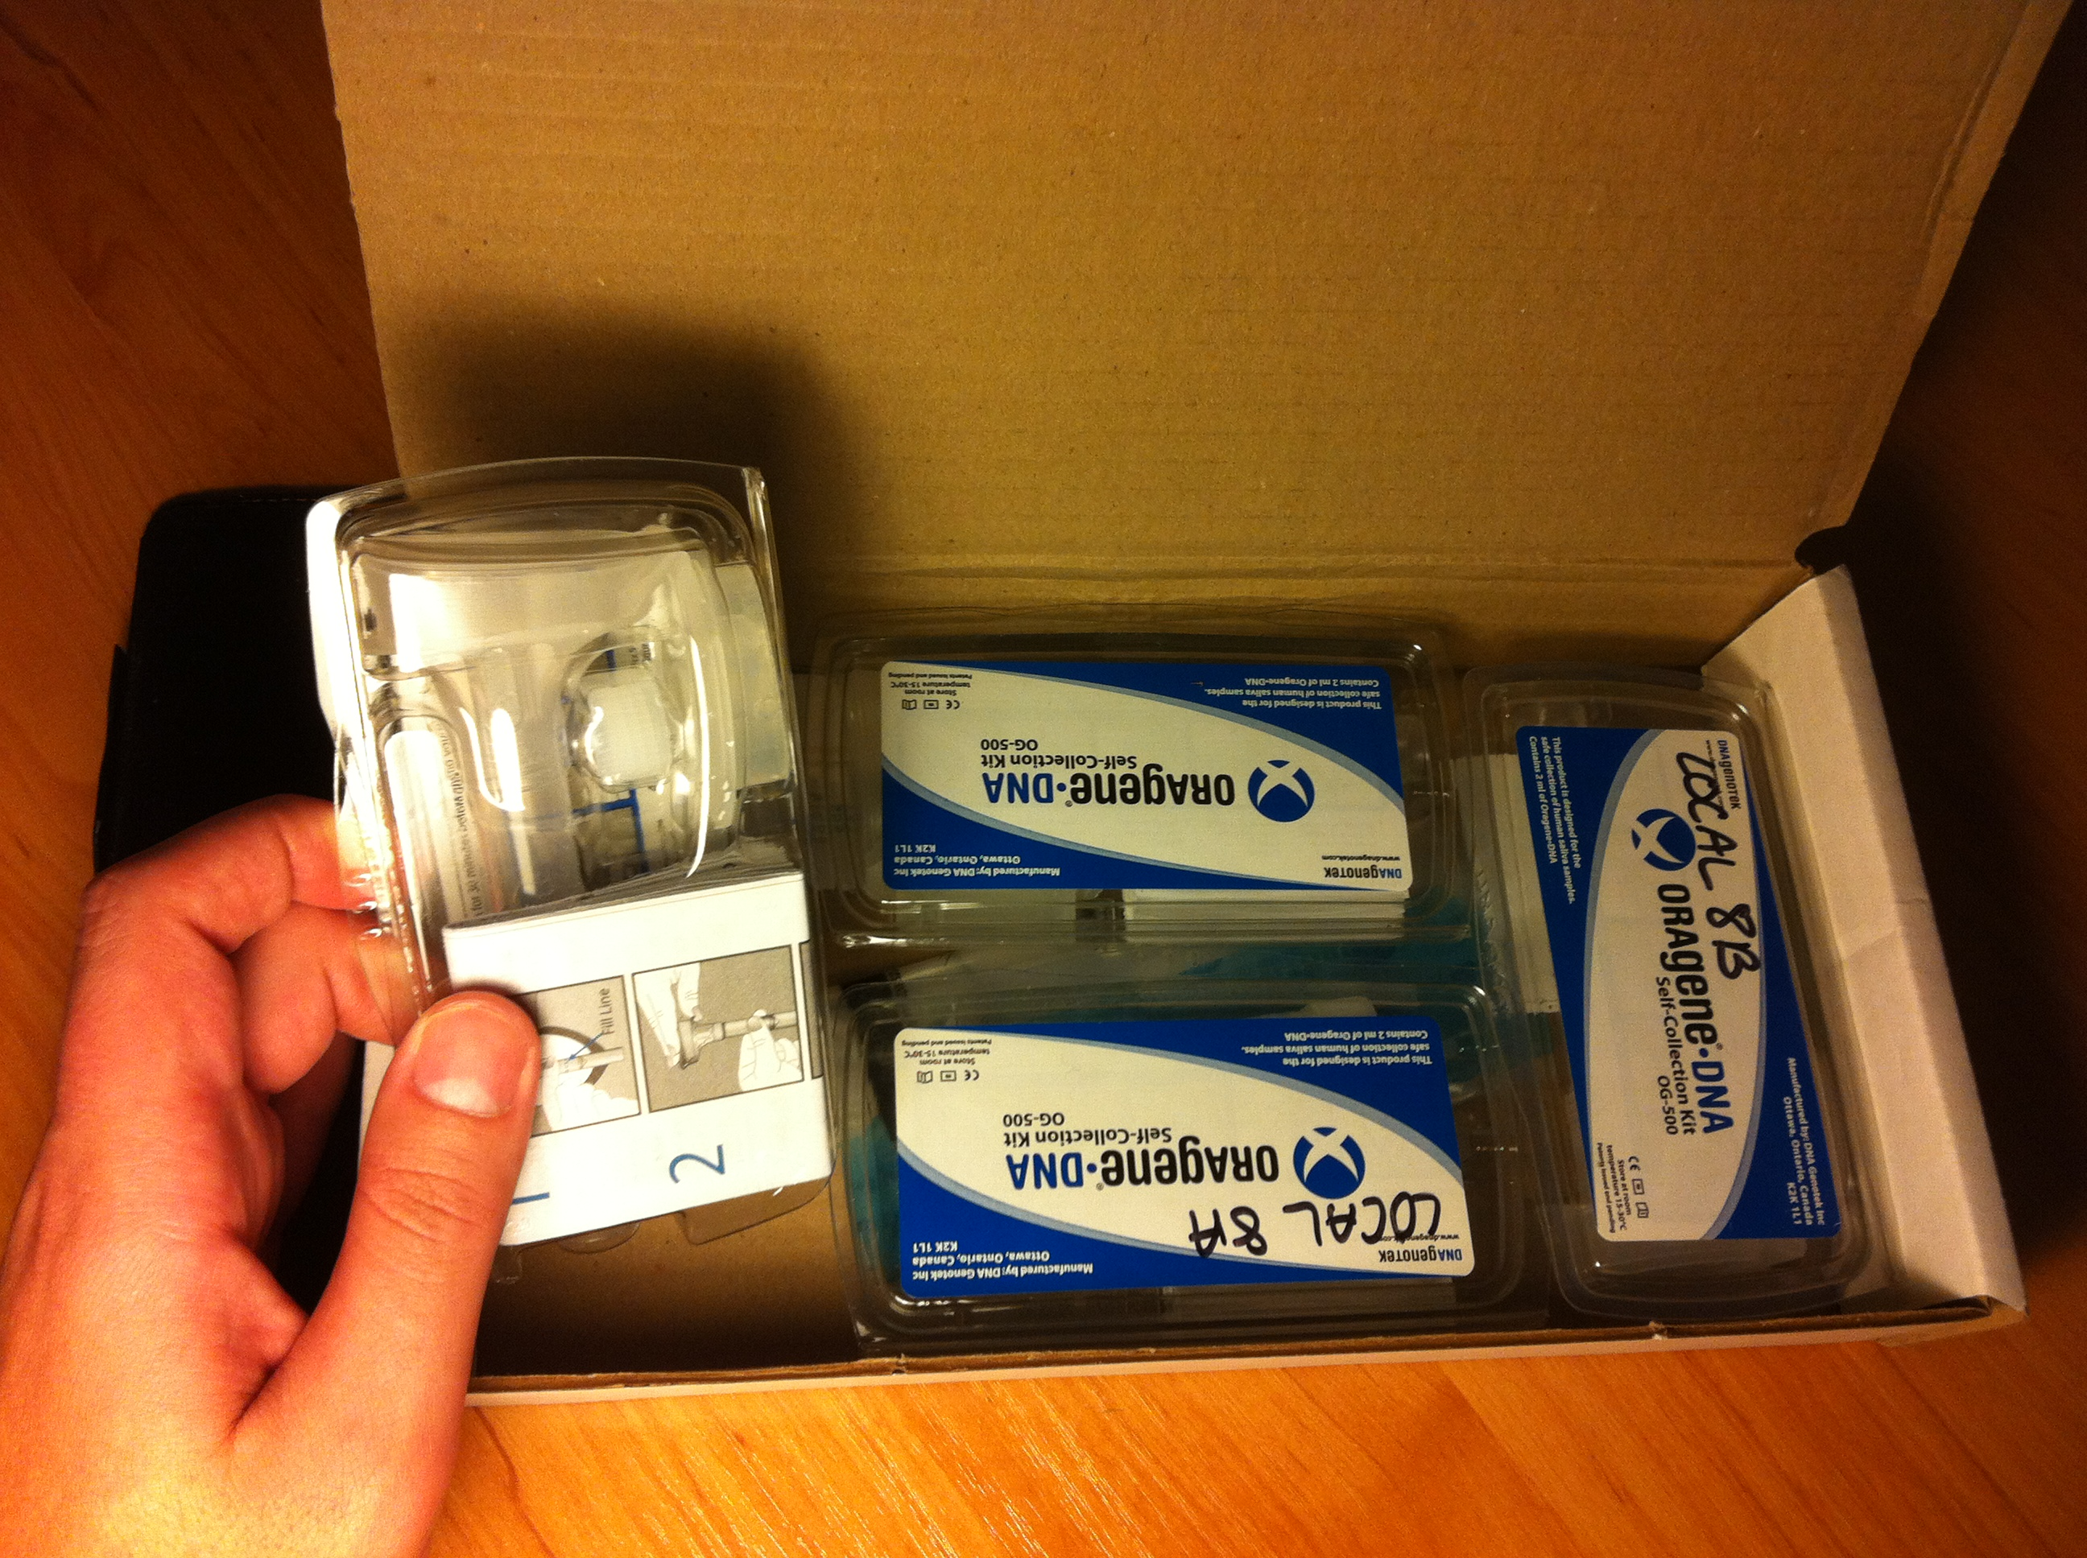

Slide 24
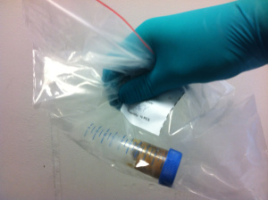
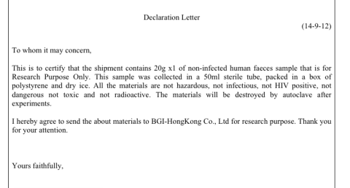
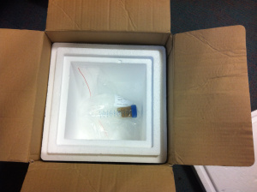
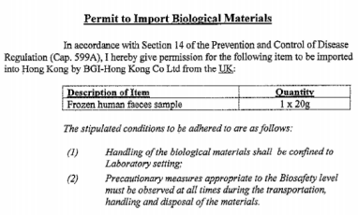

Slide 25
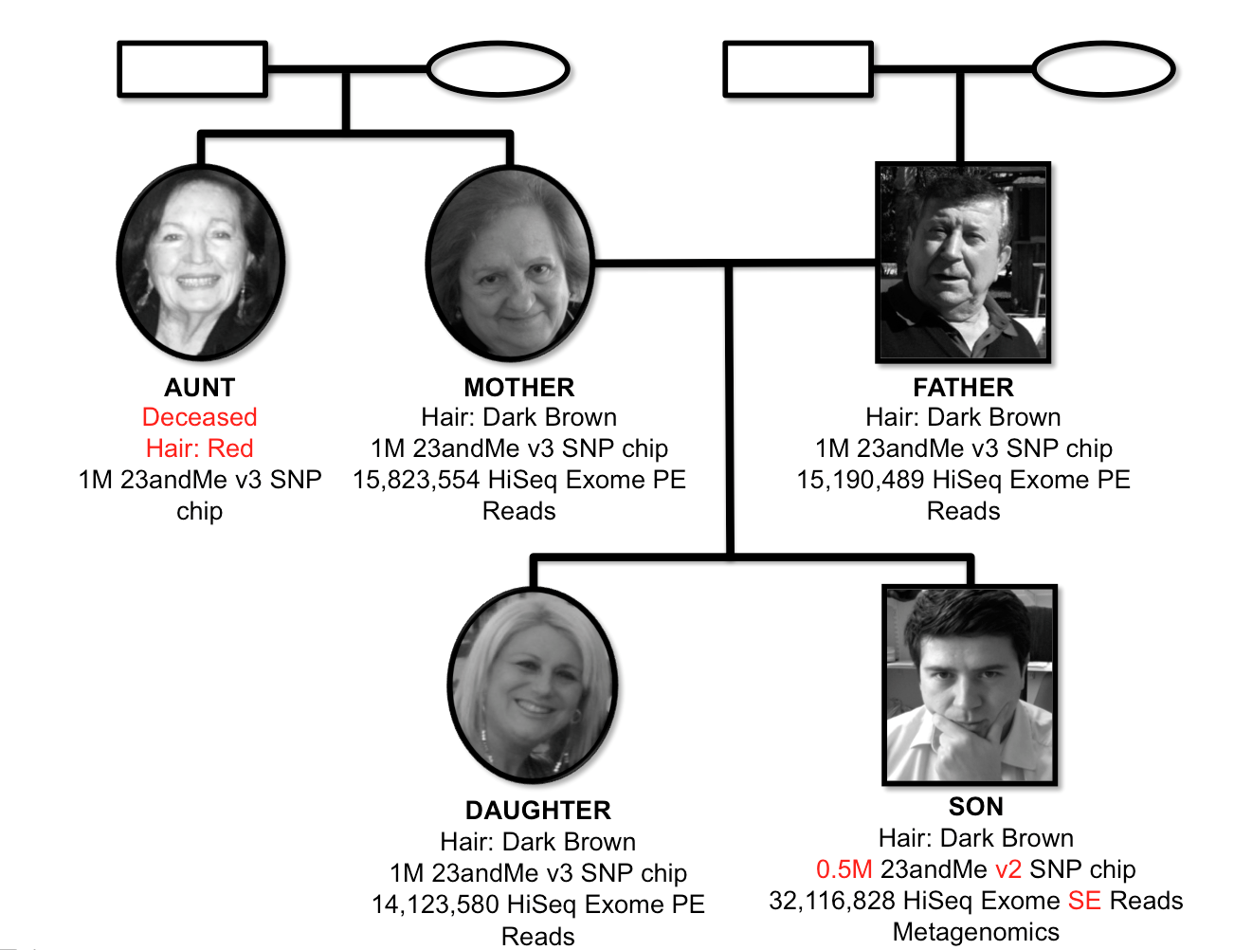

Slide 26
How did I inherit my prostate cancer risk?

Slide 27
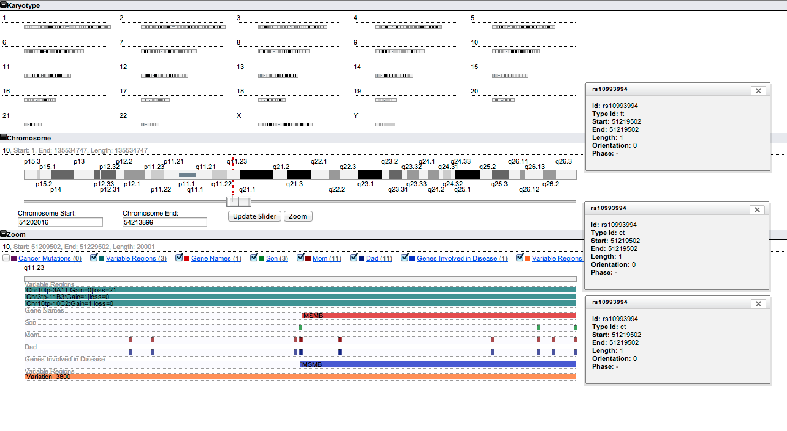

Slide 28
Is this all there is?

Slide 29
Could crowdsourcing of the analysis help?

Slide 30
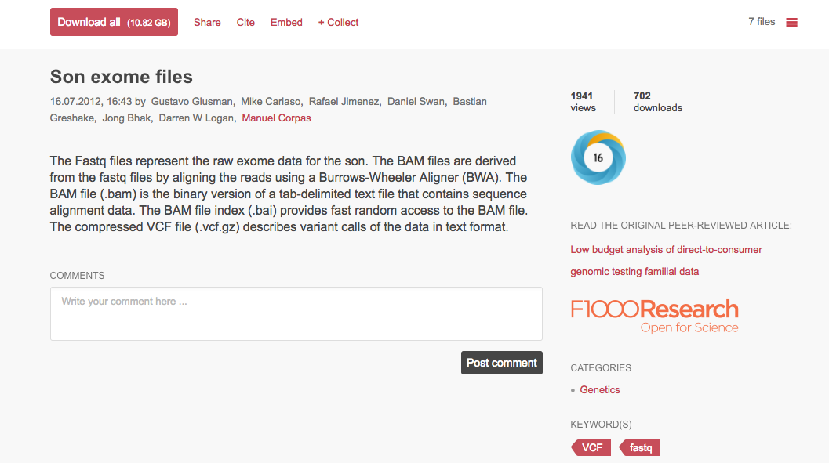

Slide 31
How did crowdsourcing help?

Slide 32
How did crowdsourcing help?
Ancestry

Slide 33
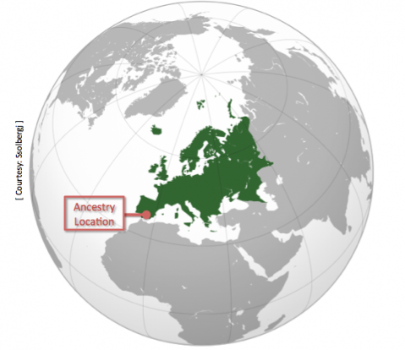

Slide 34
@manuelcorpas

Slide 35
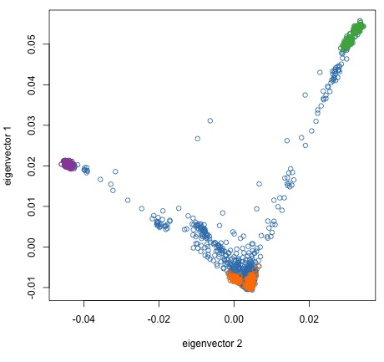
PCA of 2,402 Open Access 23andMe
+ 1000 Genomes Project
(African, Asian, European)
Notes:
1/31/17
35
35

Slide 36
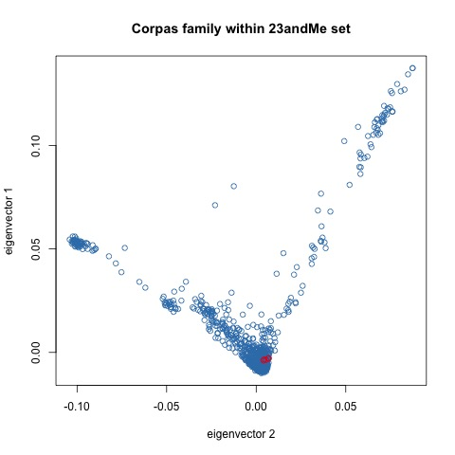
Corpas Family
The Corpas family
(red circles)
Notes:
1/31/17
36
36

Slide 37
How did crowdsourcing help?
Ancestry
Traits

Slide 38
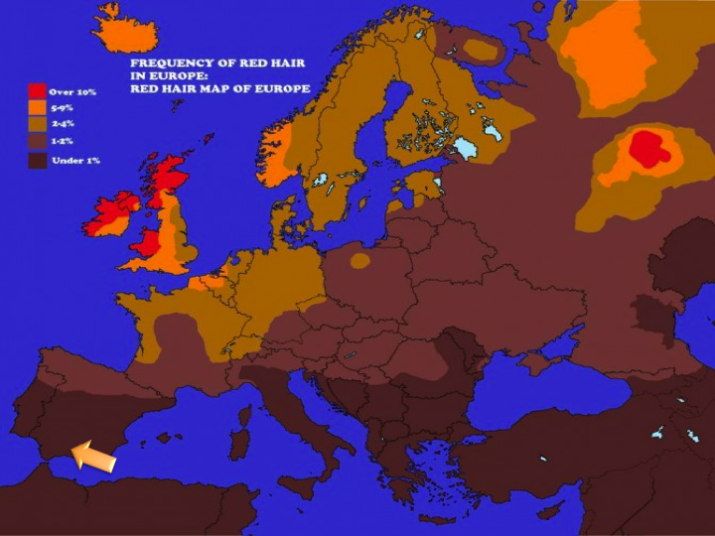

Slide 39
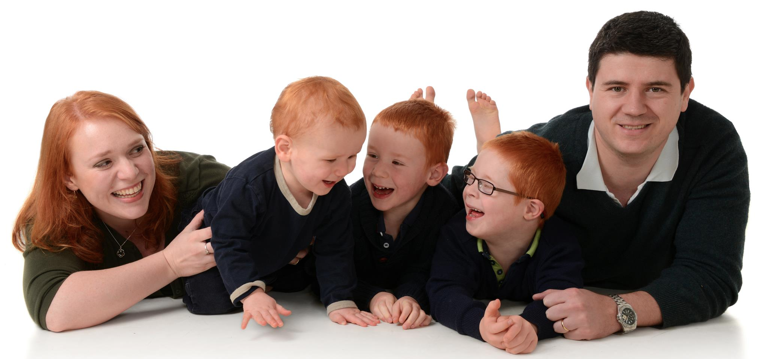

Slide 40
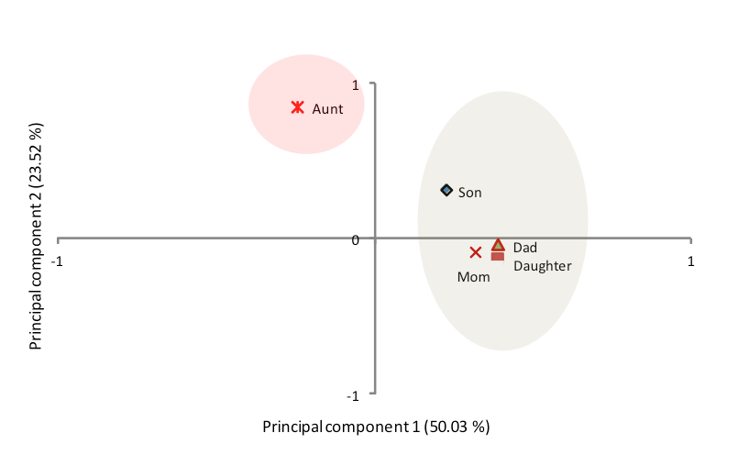

Slide 41
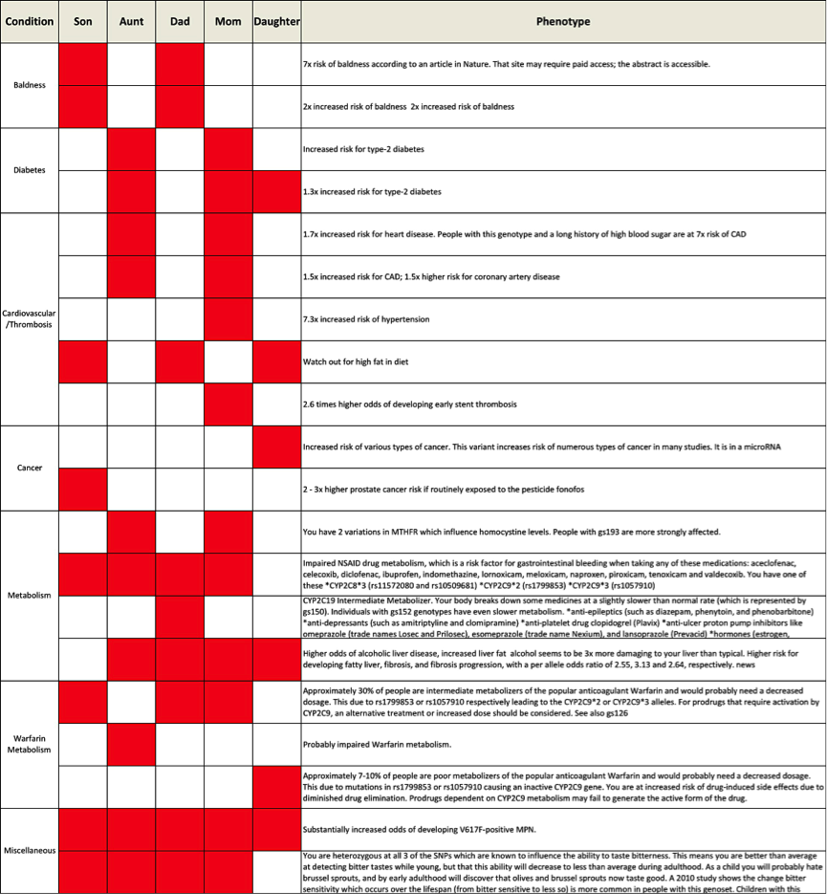

Slide 42
How did crowdsourcing help?
Ancestry
Traits
Better understanding of the data

Slide 43
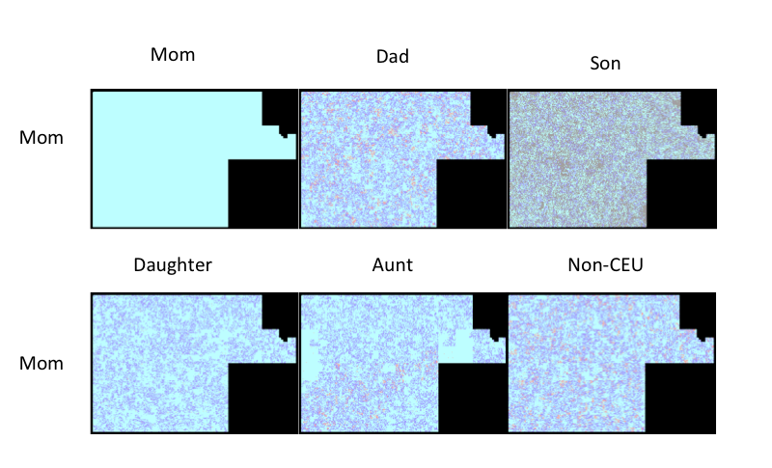
Chr1 Comparison
G. Glusman, M. Cariaso, R. Jimenez, D. Swan, B. Greshake, J. Bhak, D.W. Logan, M. Corpas* (2012). F1000 Research, 1:3

Slide 44
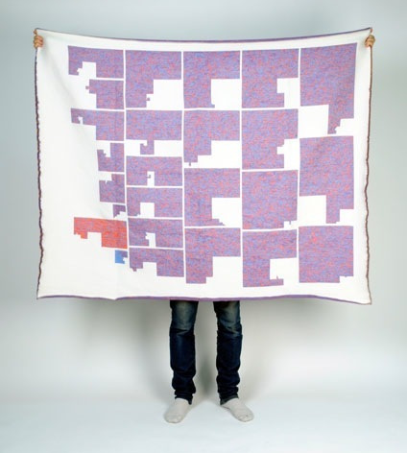

Slide 45
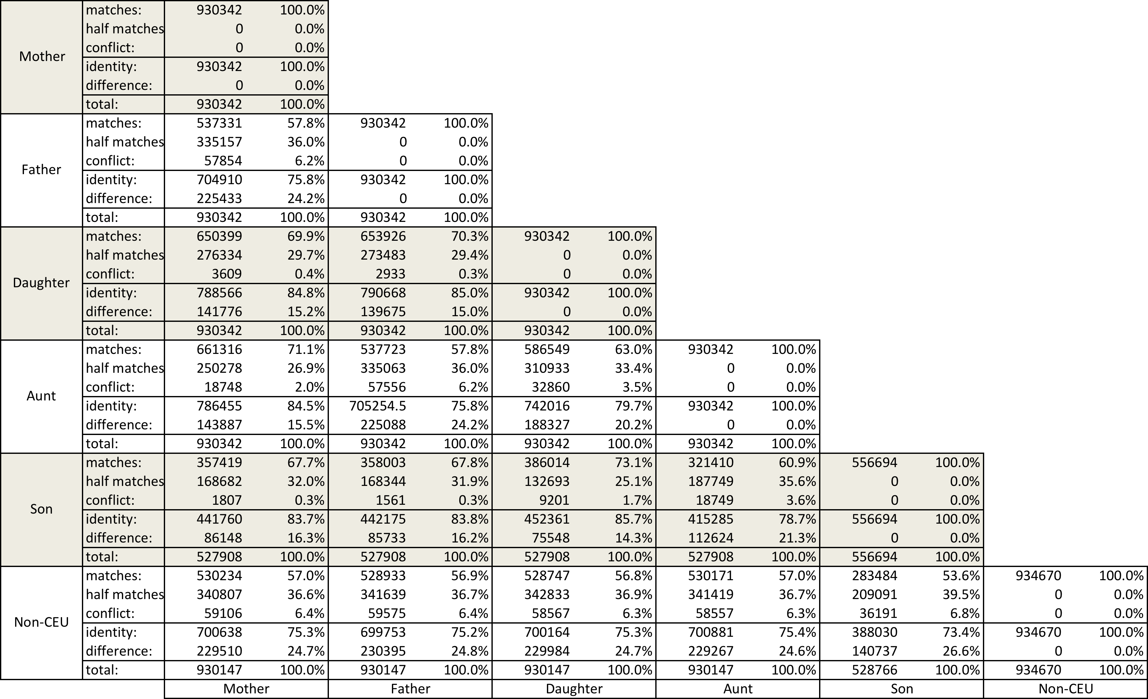
SNP identity

Slide 46
Implications

Slide 47
Family implications I
Gatekeeper of family genome data
Who has the fittest genome?
  Realisation that some genomes have fewer risks than others
  Easily quantifiable (e.g. insurance companies)
The problem of distancing myself from the person and focusing on the results
  Oscillating roles professional/son
M. Corpas* (2012). Experiences with Personal Genetics: A Family Journey. Journal of Genetic Counseling.

Slide 48
Family Implications II
Sheer volume of data, difficult to connect
DTC process appears to be mainly focused on the individual rather than the family
Easy to become drawn into believing the information provided
  slick presentation of the data, based on rigorous scientific methods, also provides a sense of credibility.
M. Corpas* (2012). Experiences with Personal Genetics: A Family Journey. Journal of Genetic Counseling.

Slide 49
My Conclusions
Intelligent exploration, experimentation and trial to push the boundaries of knowledge are a right for all.
Sharing can be more useful than keeping data to oneself.
Whatever attitude a person has towards personal genome privacy, it should be utterly respected.
M. Corpas (2012). A Genome Blogger Manifesto. GigaScience 1:15

Slide 50
Final thought
More availability of tests does not guarantee better access to personal genomic data

Slide 51
